Slide 1
Linear Regression

Slide 2
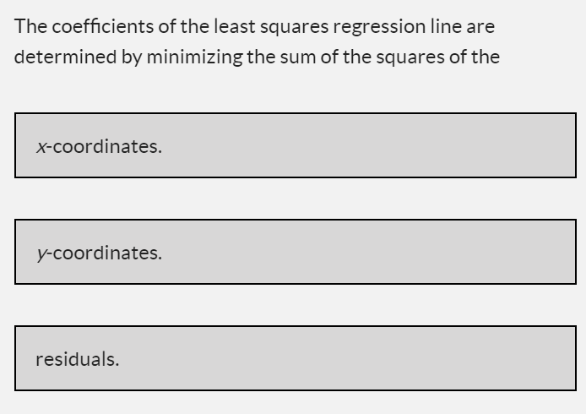
Review

Slide 3
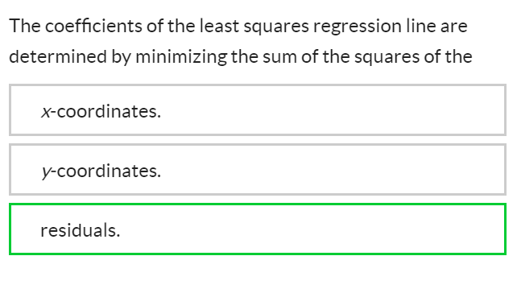
Review

Slide 4
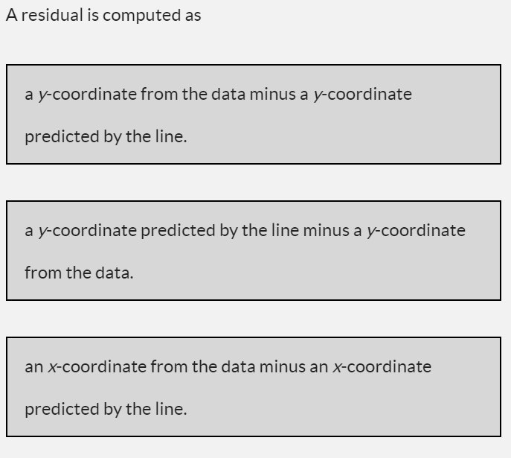
Review

Slide 5
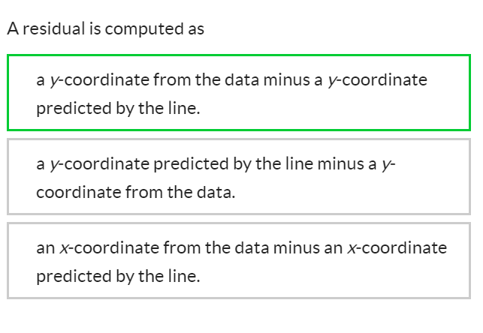
Review

Slide 6
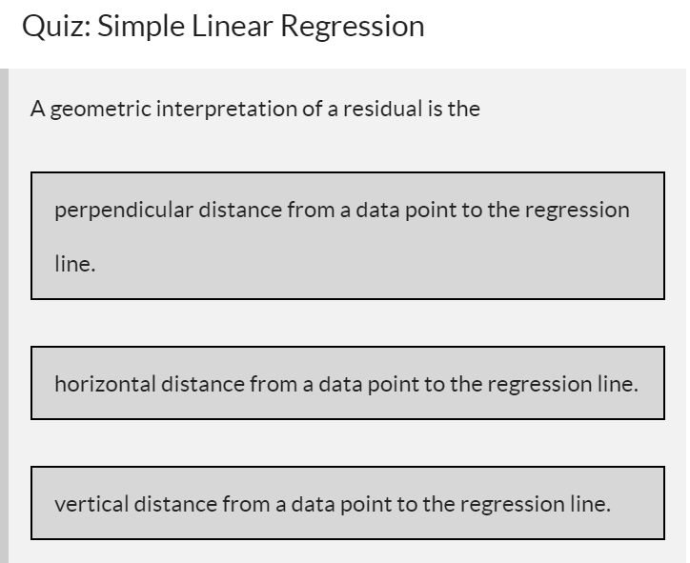
Review

Slide 7
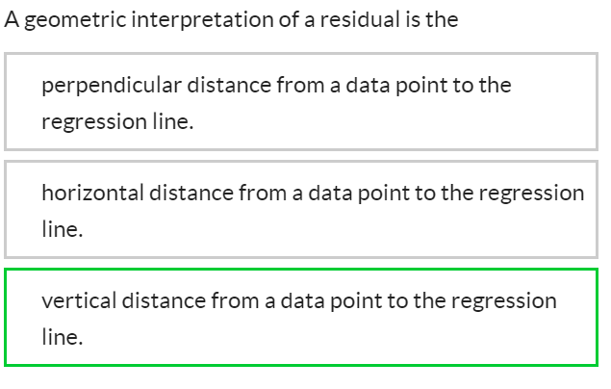
Review

Slide 8
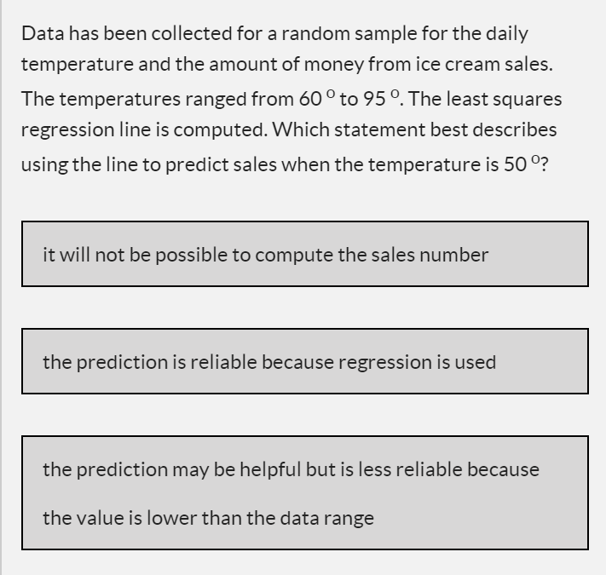
Review

Slide 9
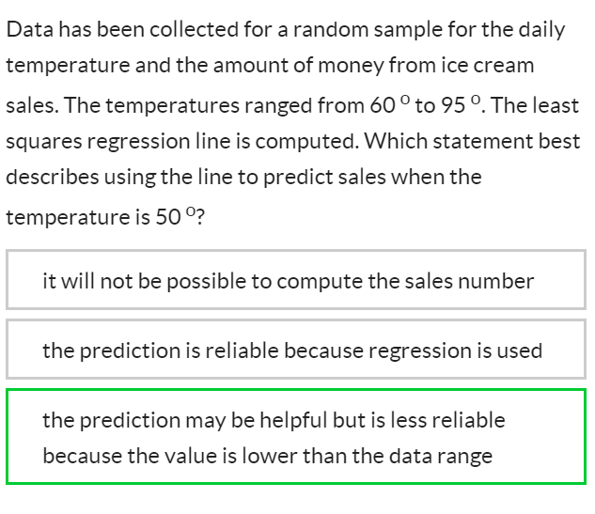
Review

Slide 10
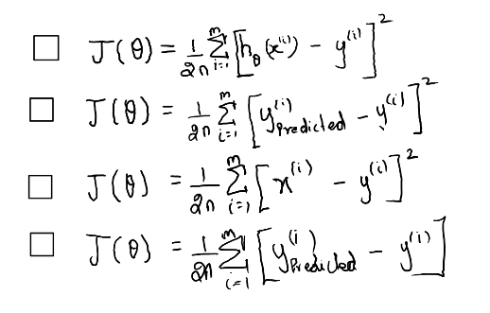
Cost Function

Slide 11
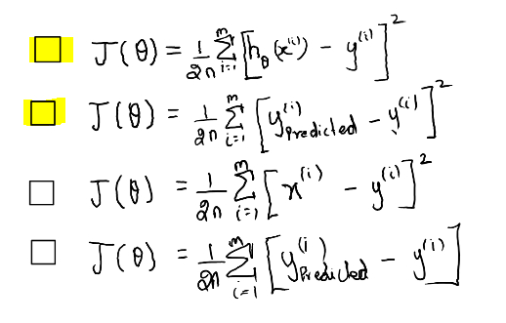
Cost Function

Slide 12
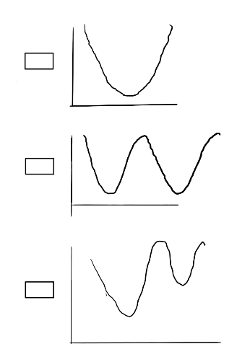
Convex Function

Slide 13
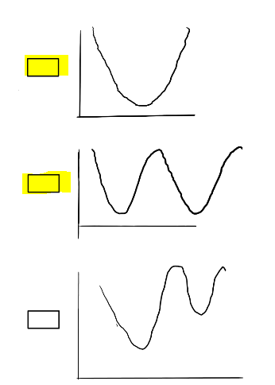
Convex Function

Slide 14
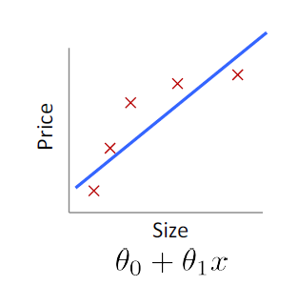
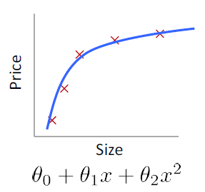
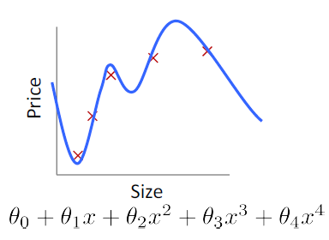
Best Fit?

Slide 15
Best Fit?

Slide 16
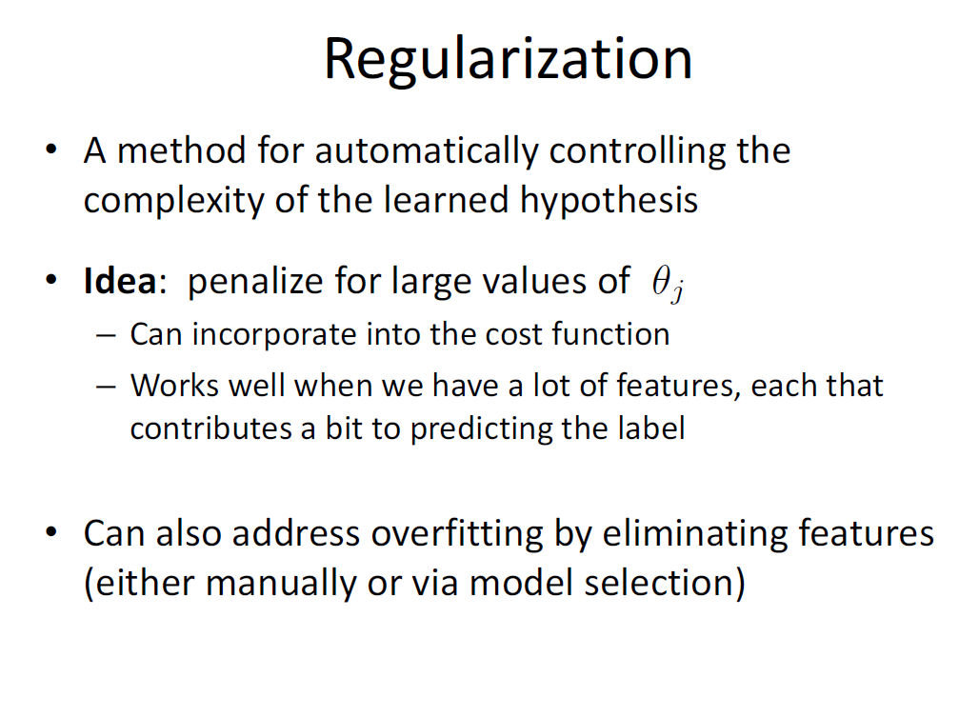

Slide 17
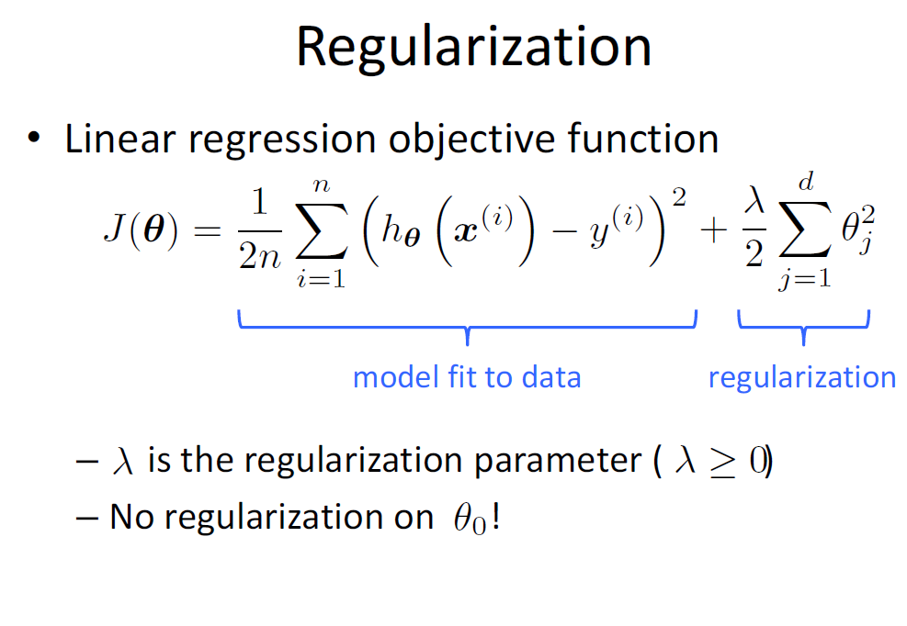

Slide 18
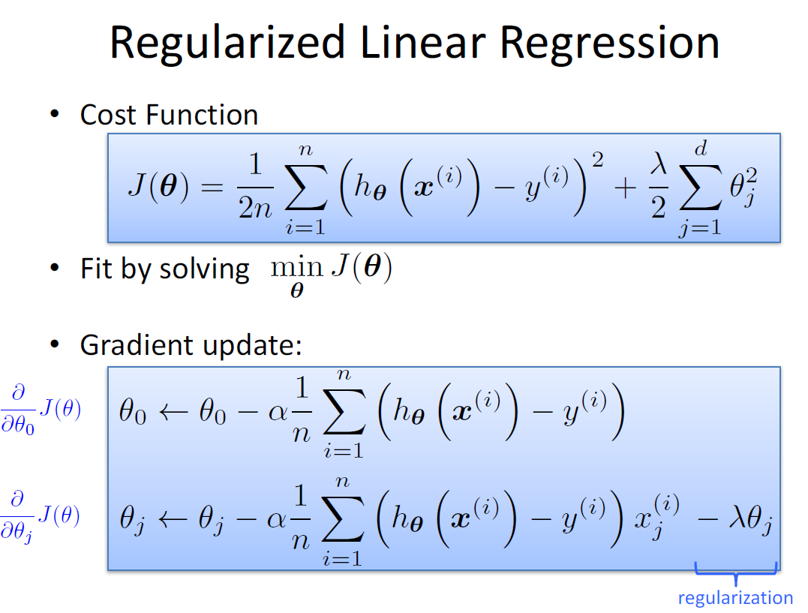

Slide 19
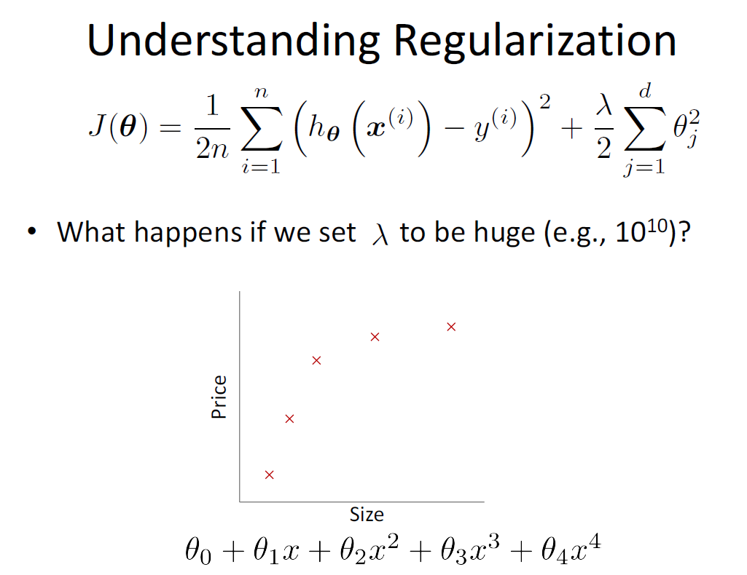

Slide 20
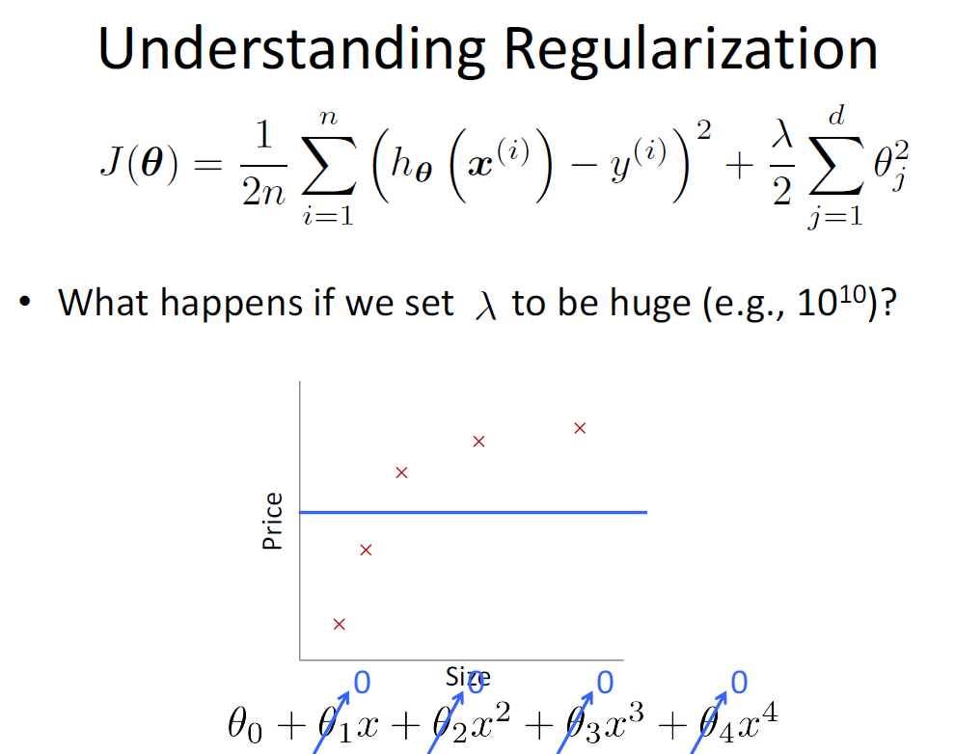

Slide 21
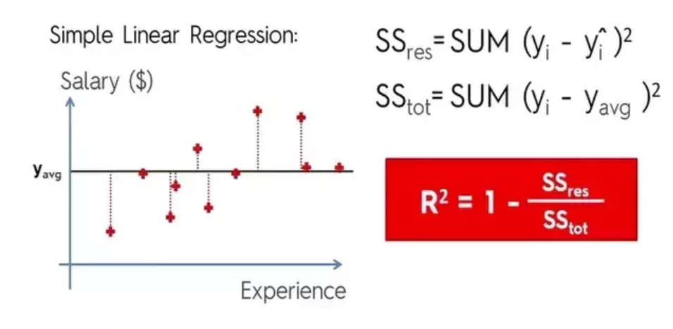
Metric for Regression

Slide 22
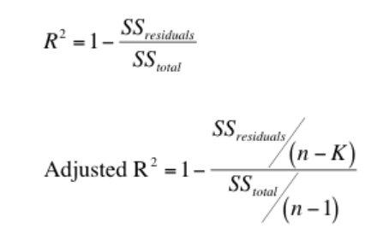
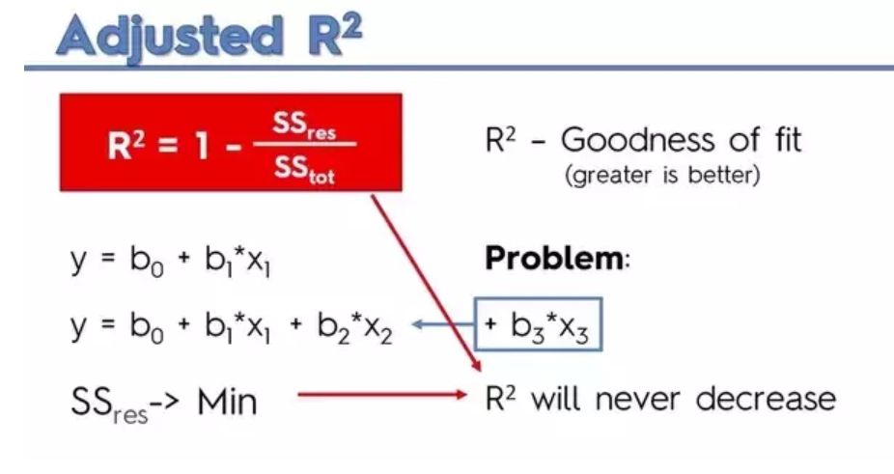
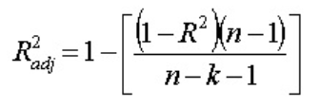
Metric for Regression

Slide 23
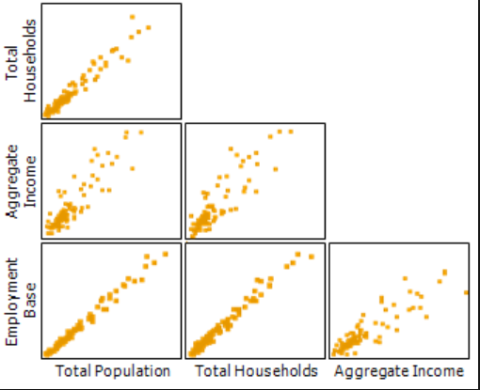
Multicollinearity
Multicollinearity is a state of very high intercorrelations or inter-associations among the independent variables. It is therefore a type of disturbance in the data, and if present in the data the statistical inferences made about the data may not be reliable.
Description

Slide 24
Multicollinearity
There are certain reasons why multicollinearity occurs:
It is caused by an inaccurate use of dummy variables.
It is caused by the inclusion of a variable which is computed from other variables in the data set.
Multicollinearity can also result from the repetition of the same kind of variable.
Generally occurs when the variables are highly correlated to each other.
Multicollinearity can result in several problems. These problems are as follows:
The partial regression coefficient due to multicollinearity may not be estimated precisely. The standard errors are likely to be high.
Multicollinearity results in a change in the signs as well as in the magnitudes of the partial regression coefficients from one sample to another sample.
Multicollinearity makes it tedious to assess the relative importance of the independent variables in explaining the variation caused by the dependent variable.
Problems

Slide 25
Multicollinearity
Correlation Score
VIF
Detection

Slide 26
Multicollinearity
Remove one of the correlated columns. But you will lose information
Try combining the two correlated columns. Item_Price_per_unit_weight=Item_MRP/Item_Weight
Use Dimensionality Reduction like PCA
Solution

Slide 27
AutoCorrelation
Autocorrelation
Autocorrelation is a characteristic of data in which the correlation between the values of the same variables is based on related objects. It violates the assumption of instance independence, which underlies most of the conventional models. It generally exists in those types of data-sets in which the data, instead of being randomly selected, is from the same source.
Detecting the Presence
There is a very popular test called the Durbin Watson test that detects the presence of autocorrelation. If the researcher detects autocorrelation in the data, then the first thing the researcher should do is to try to find whether or not it is pure. If it is pure, then one can transform it into the original model that is free from pure autocorrelation.
Solution
Use Time-Series Algorithms

